Slide 1
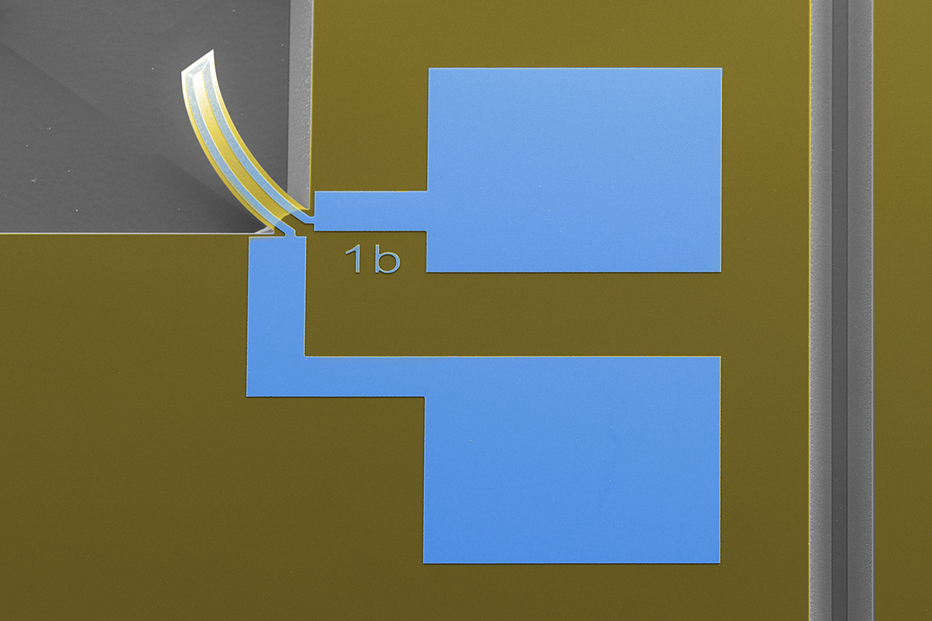

Thermal microactuator
Mask Design
MICRO-373 Advanced microfabrication practicals
Spring semester – 2025
Mask Design Session – Friday 14.03.2025

Slide 2
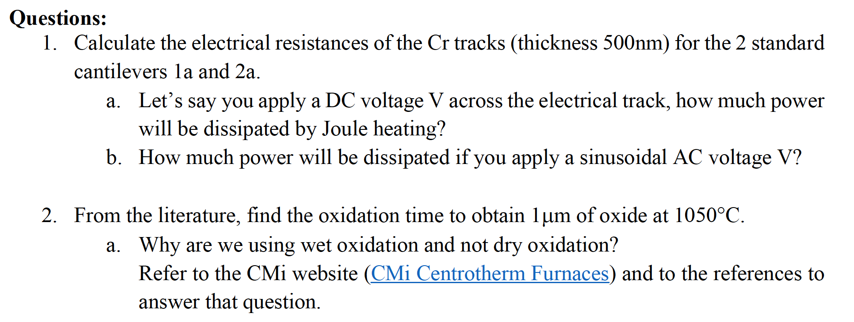
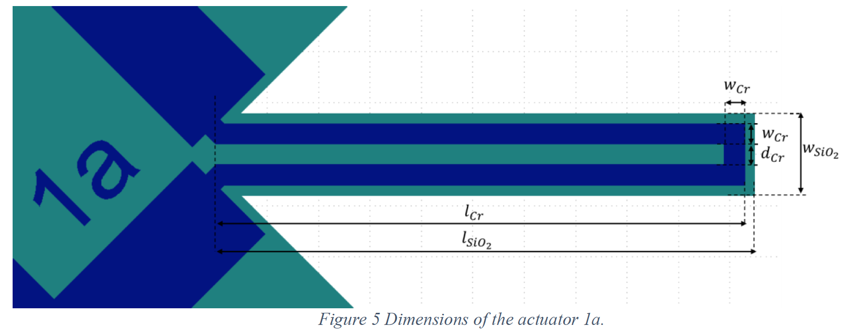

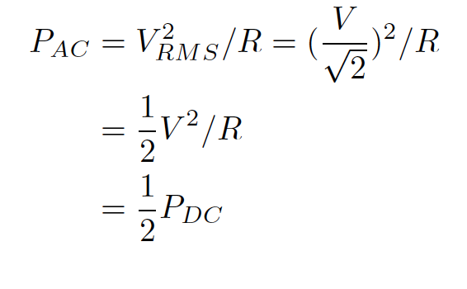
Theory
Take the full Cr path on the cantilevers

Slide 3
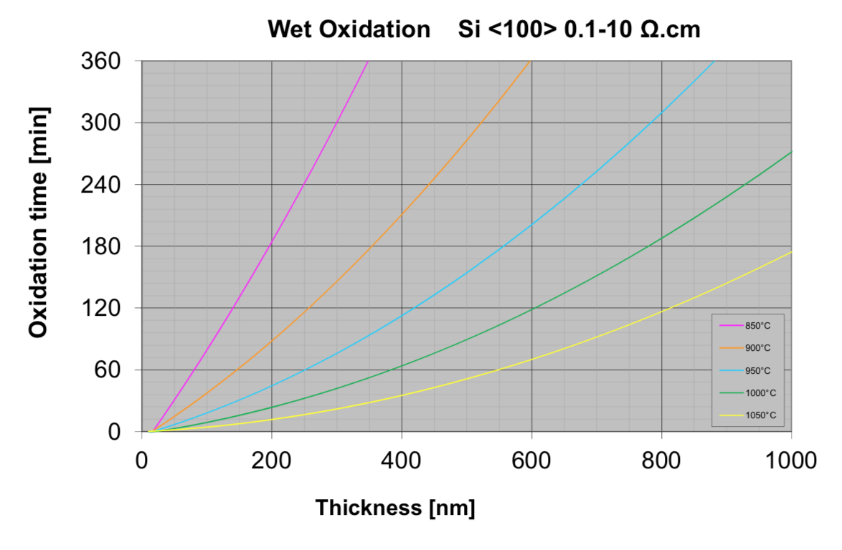
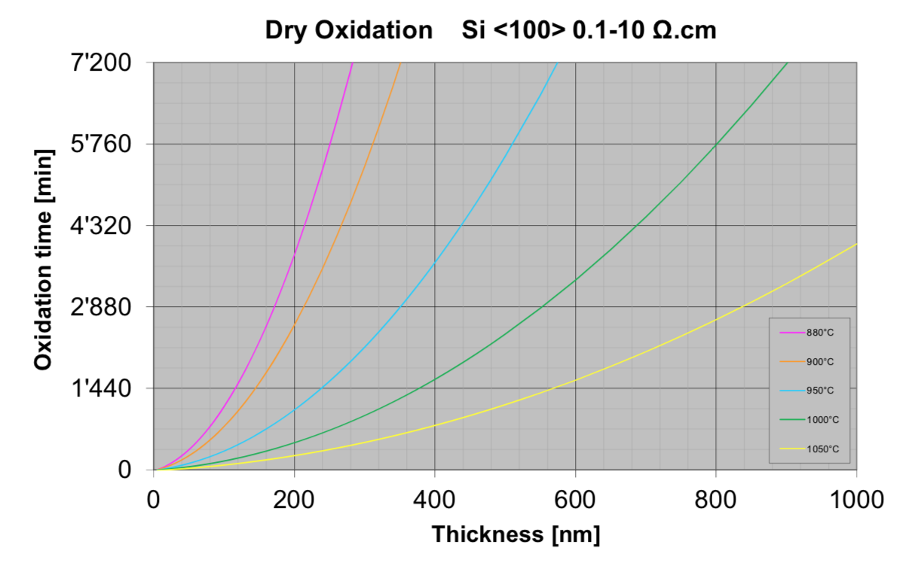
Theory

Slide 4
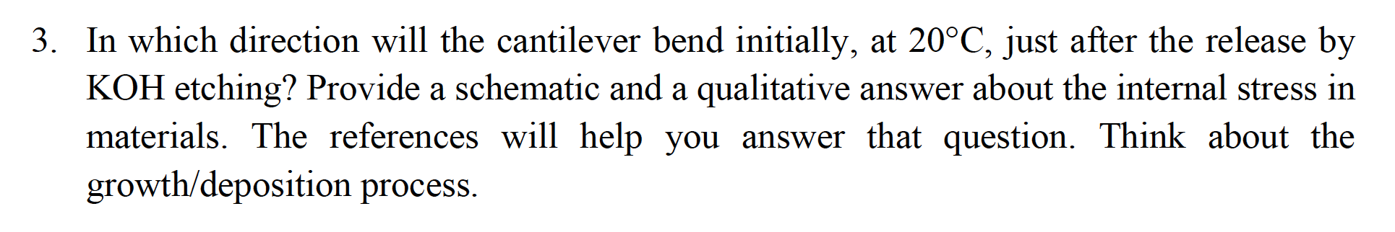
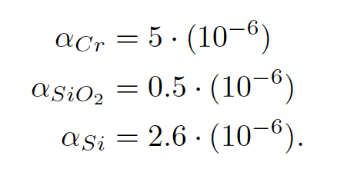
Theory
Cantilever bends up.
Explain why.

Slide 5
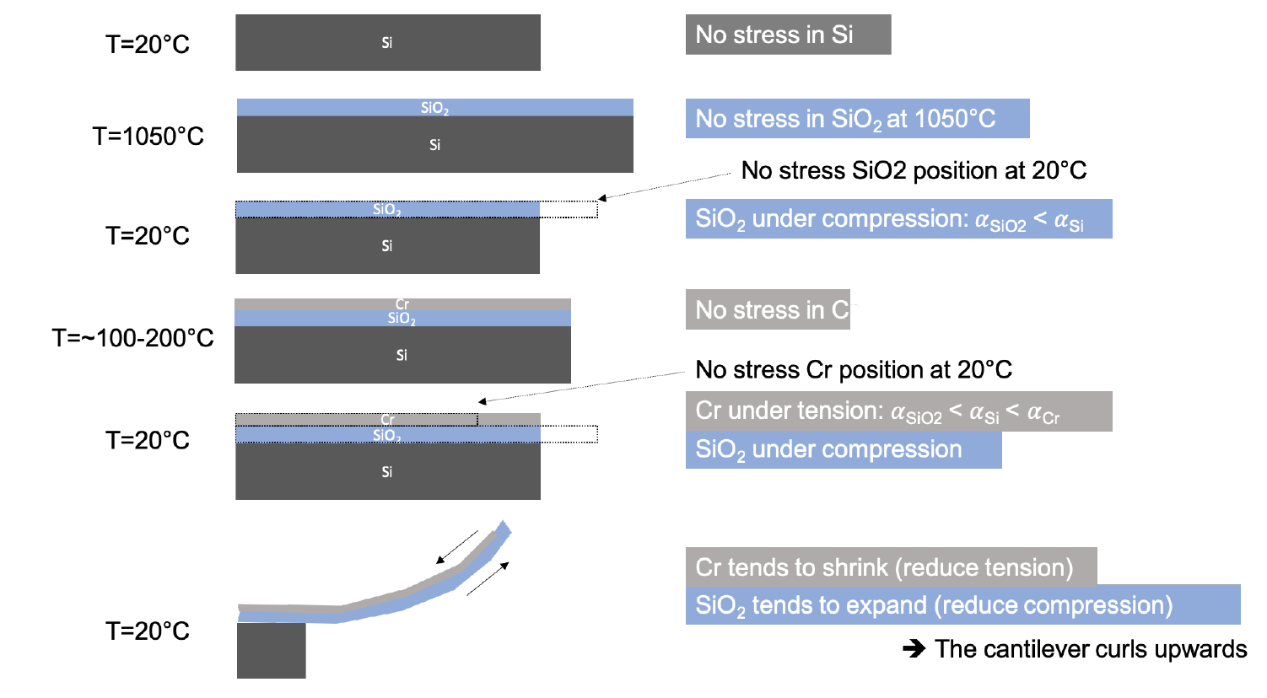
Theory

Slide 6
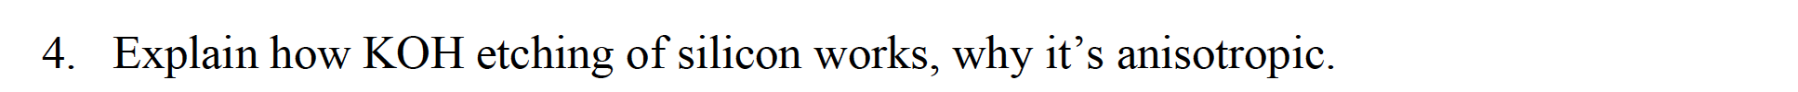
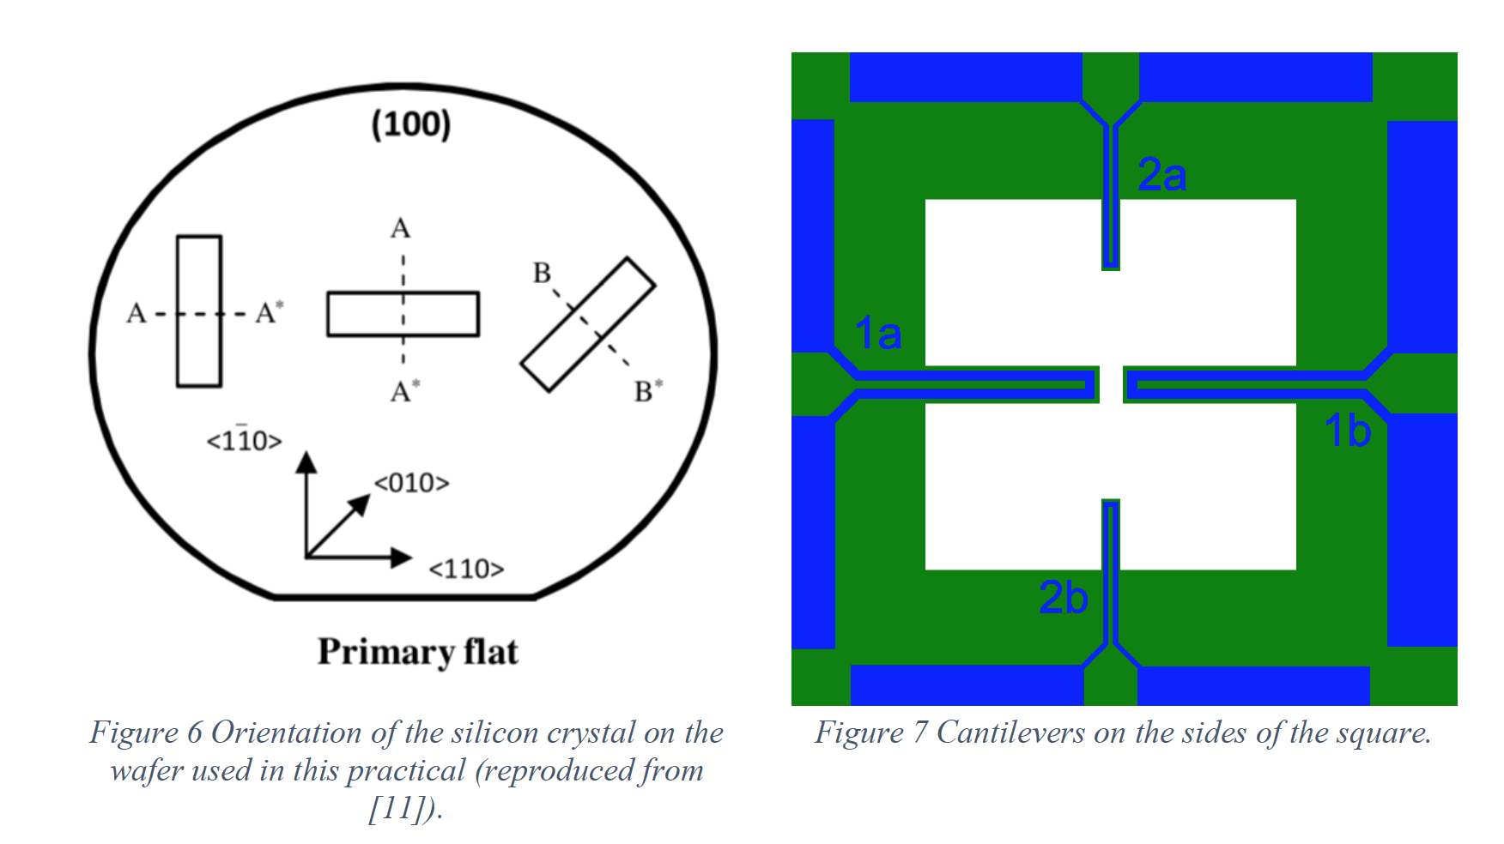
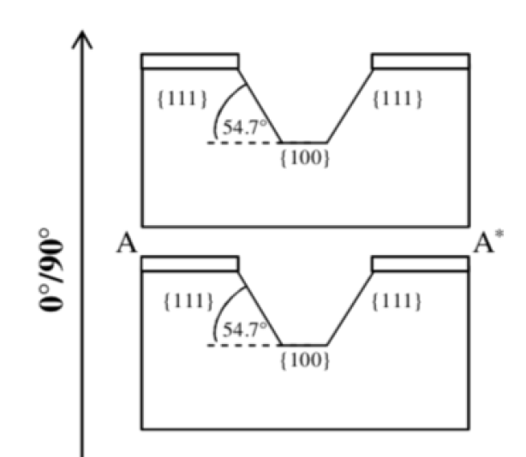
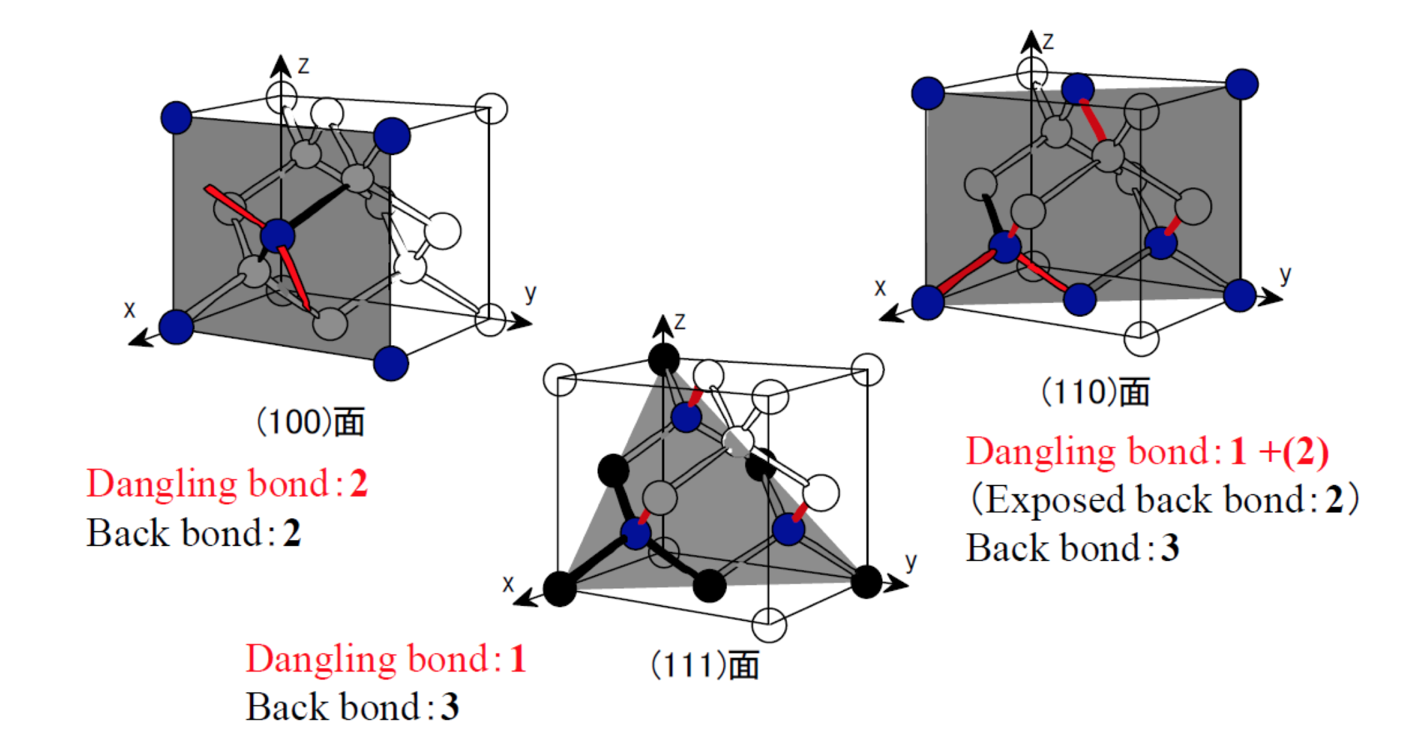
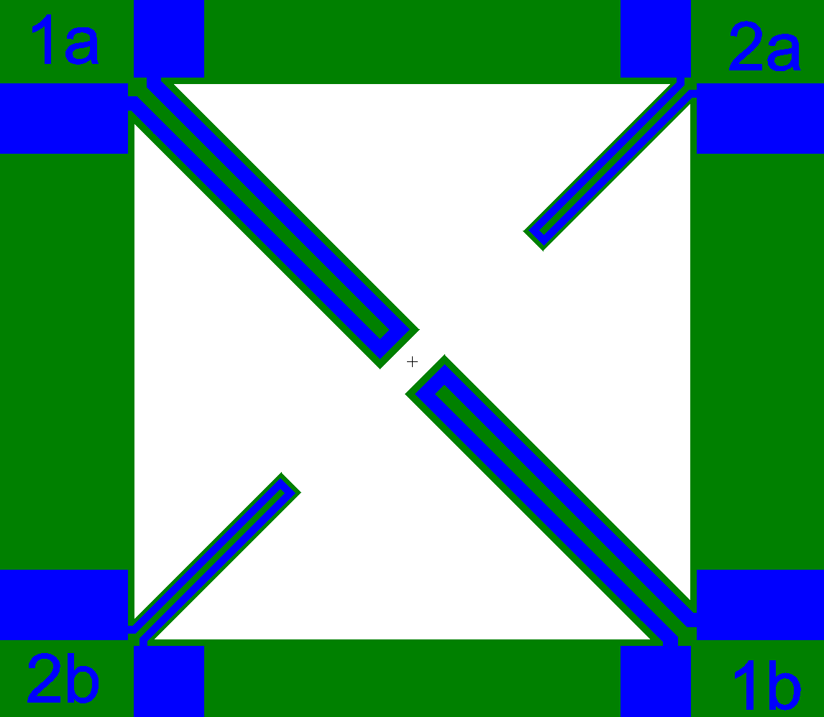
Theory
Also, check
https://nanohub.org/resources/25355/download/2016.04.13-ECE695Q-L44.pdf
https://www.youtube.com/watch?v=ySpo5e2r63k
https://www.youtube.com/watch?v=-kWu4--n1JQ
Notes:
https://nanohub.org/resources/25355/download/2016.04.13-ECE695Q-L44.pdf
https://www.youtube.com/watch?v=ySpo5e2r63k

Slide 7
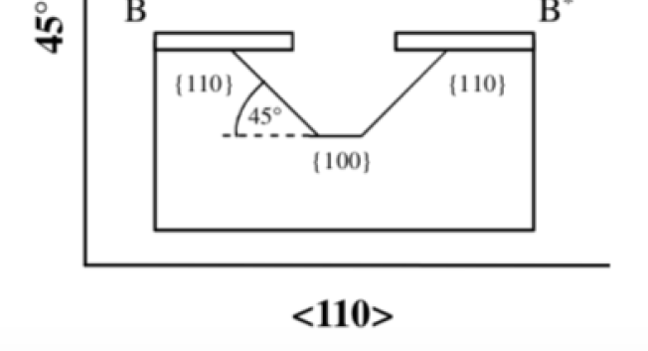
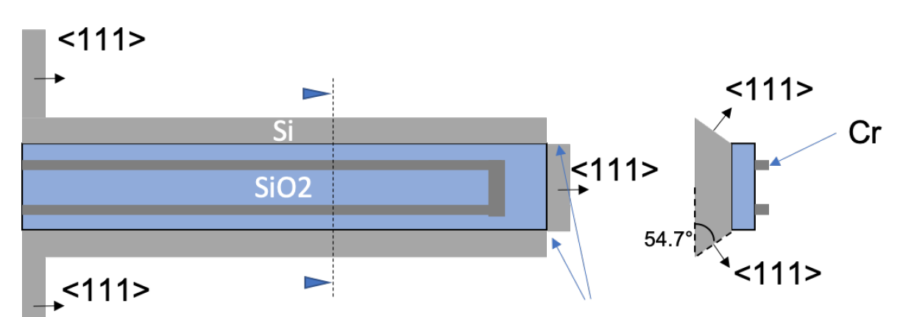
Theory
Also, check https://www.youtube.com/watch?v=ySpo5e2r63k
Notes:
https://nanohub.org/resources/25355/download/2016.04.13-ECE695Q-L44.pdf
https://www.youtube.com/watch?v=ySpo5e2r63k

Slide 8
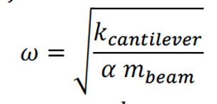
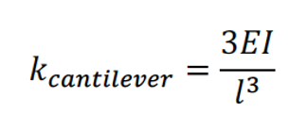
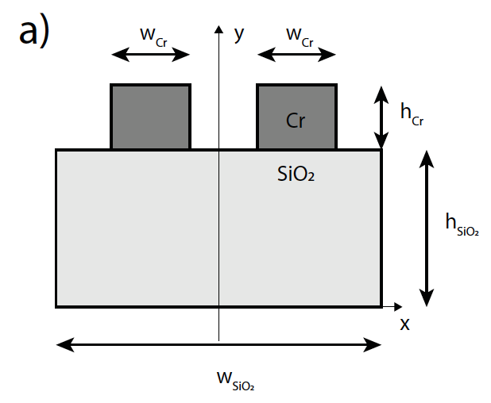
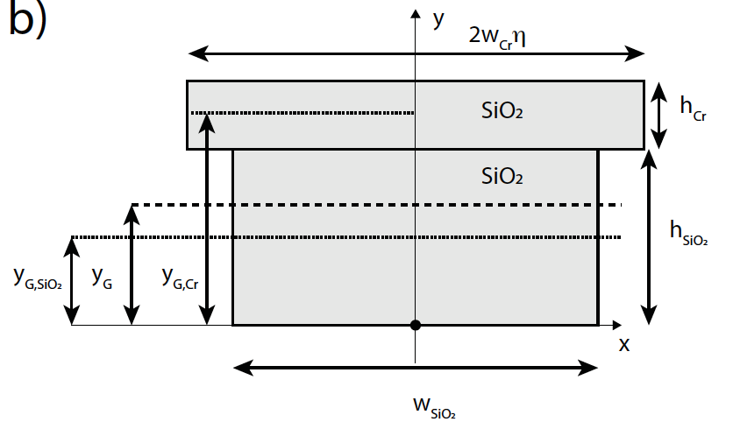
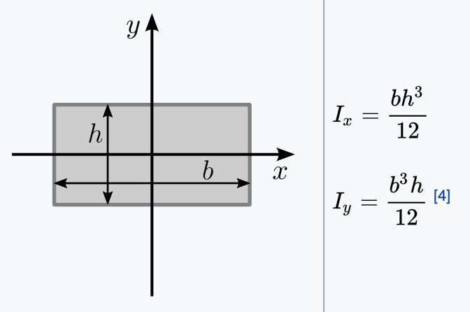
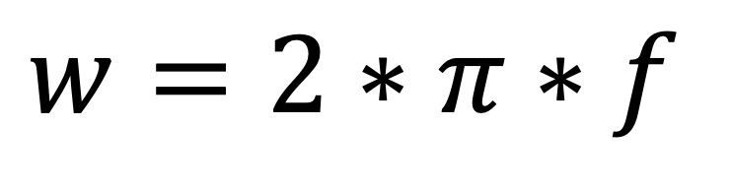
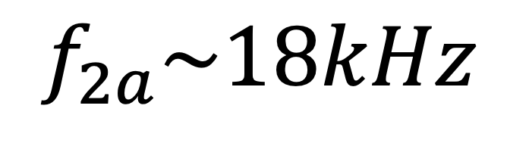

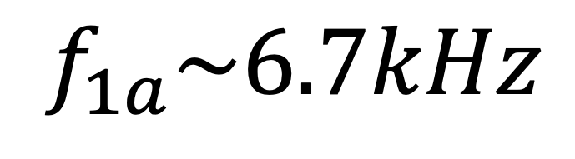
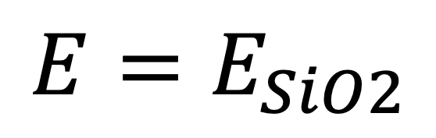



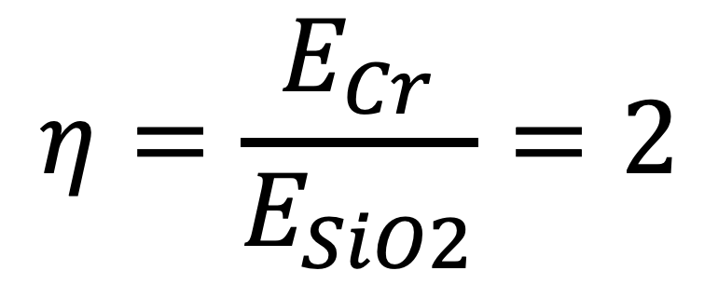

Theory – question 5
$$η=\frac{E_{Cr}}{E_{SiO2}}=2$$
$$E=E_{SiO2}$$
$$w=2∗π∗f$$
$h_{Cr}$=0.5µm
$$f_{1a}\sim 6.7kHz$$
$$h_{tot}=2µm$$
$$h_{sio2}=1.5µm$$
$$f_{2a}\sim 18kHz$$
$$y_{G}=x µm$$
$$2∗η∗w_{cr}=w_{sio2}=80µm$$

Slide 9
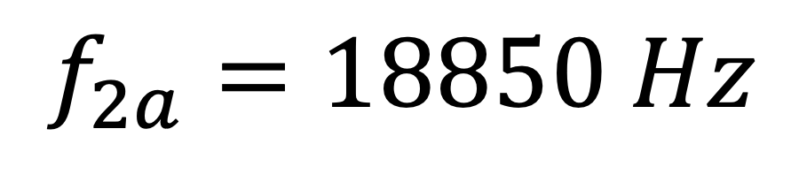
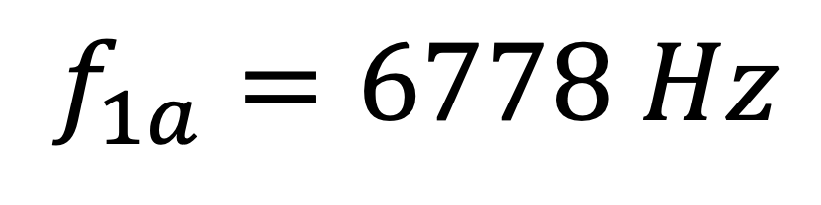
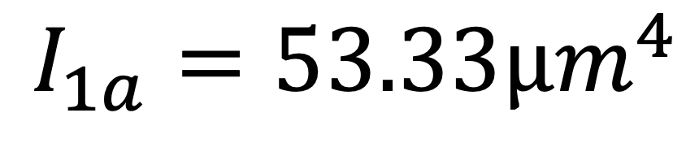

Theory – question 5
$$η=\frac{E_{Cr}}{E_{SiO2}}=2$$
$$E=E_{SiO2}$$
$$w=2∗π∗f$$
$h_{Cr}$=0.5µm
$$f_{1a}=6778 Hz$$
$$h_{tot}=2µm$$
$$h_{sio2}=1.5µm$$
$$f_{2a}=18850 Hz$$
$$y_{G}=1µm$$
$$I_{1a}=53.33µm^{4}$$
$$2∗η∗w_{cr}=w_{sio2}=80µm$$

Slide 10
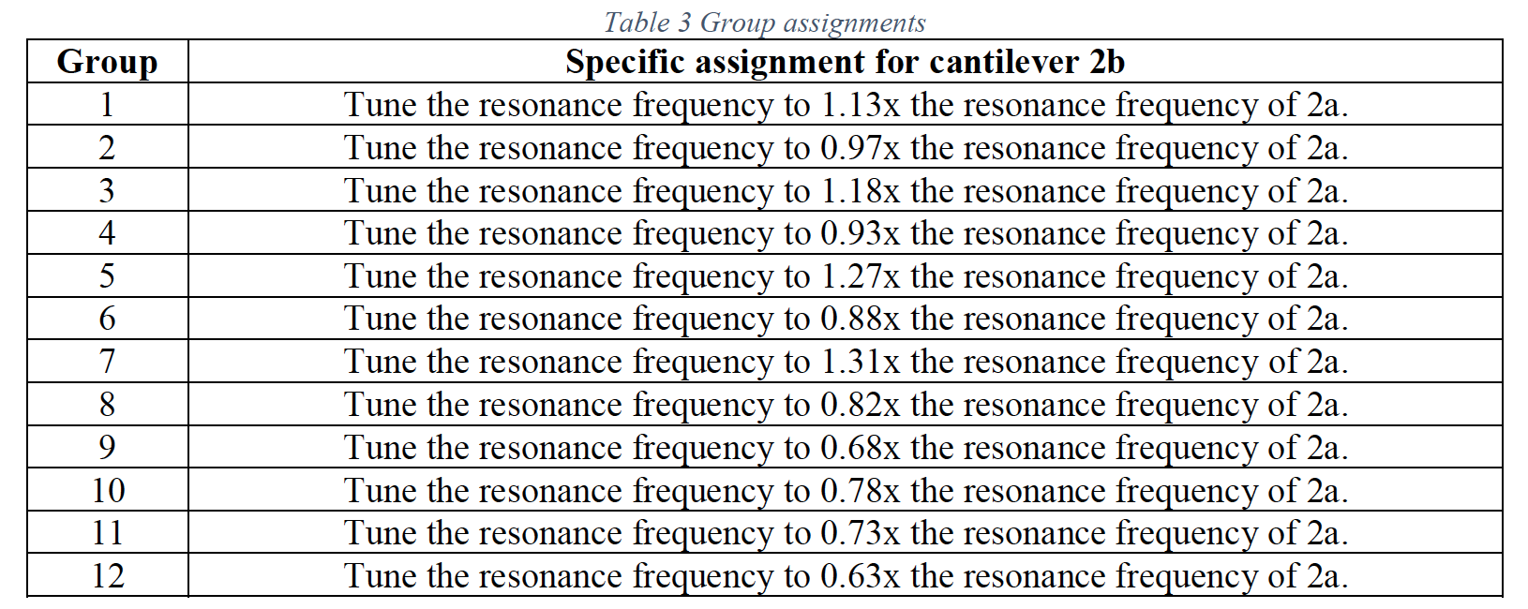
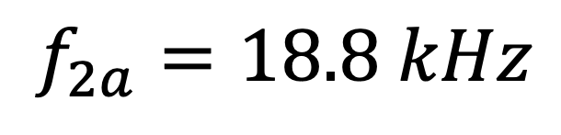
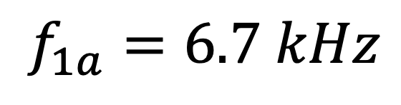
Mask design session
Adjust your computations so that your formulas match the resonance frequencies of the beams
Compute what the resonance frequency of your modified 2b cantilever should be
Figure out a way to obtain that frequency by modifying the design of 2b
  We can’t modify the thickness of the SiO2, nor the one of the Cr
Implement the modifications in the klayout design file Topic2-373-Standard4.GDS
$$f_{1a}=6.7 kHz$$
$$f_{2a}=18.8 kHz$$

Slide 11
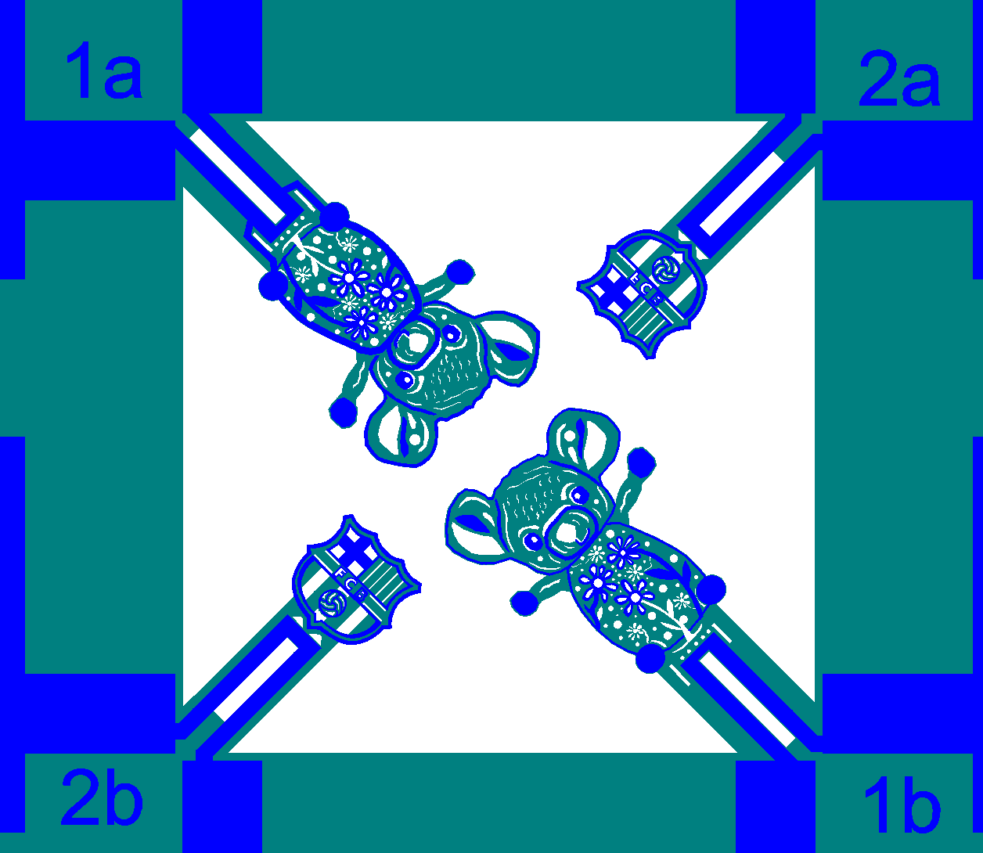

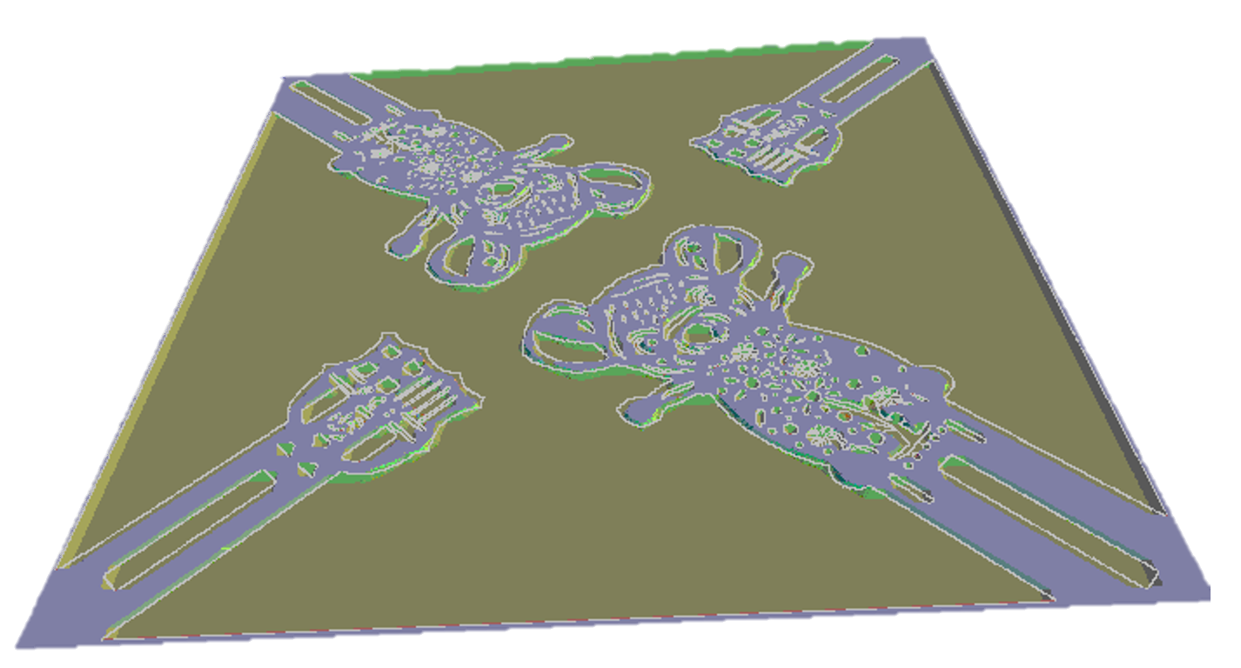
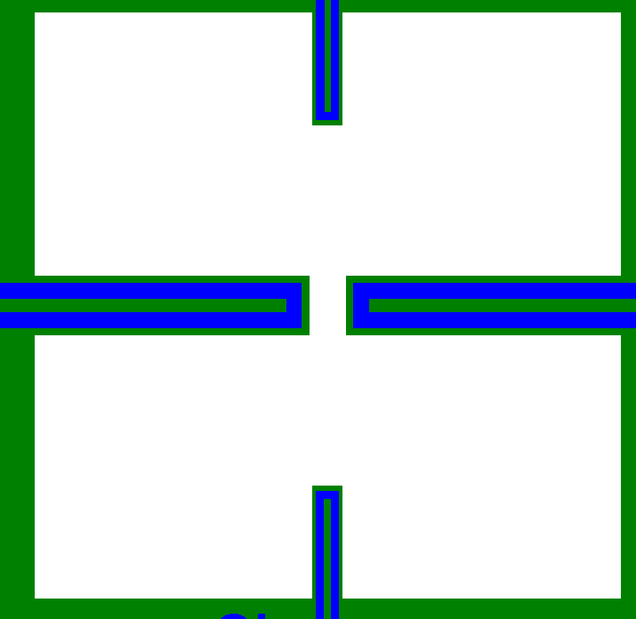
Mask design session
Freely design your 1b cantilever on klayout
Follow the instructions to get a screenshot of your SiO2 mask
Run the ACES simulation on the screenshot
  Report the evolution of the etching at 30, 60, 90, 130 minutes on your first version.
  Update your design until the cantilevers get released by KOH within 130 minutes of etching
  Report the evolution of the etching at 30, 60, 90, 130 minutes on the final design and comment the updates
Test the ACES simulation on a design with the cantilever on the sides and explain.

Slide 12

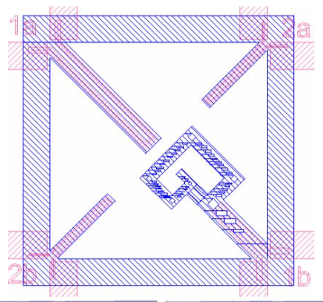
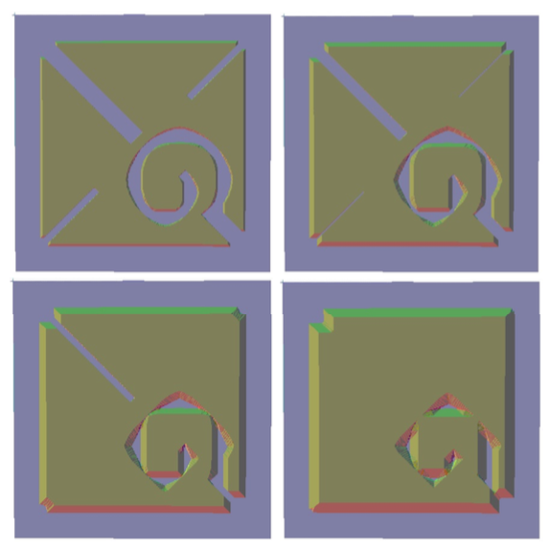
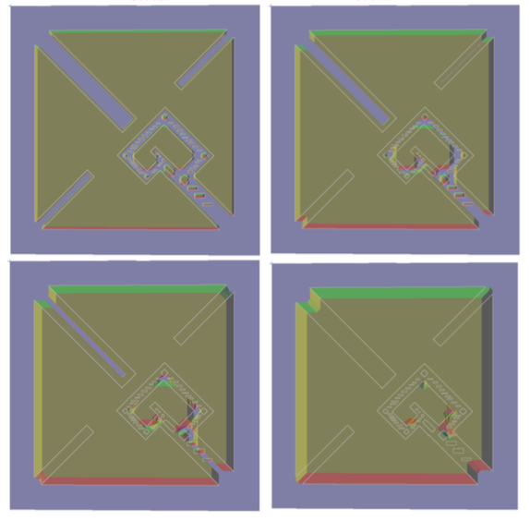
Etching simulation
Initial design
Updated design

Slide 13
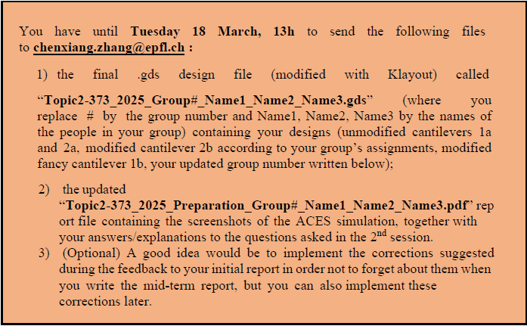
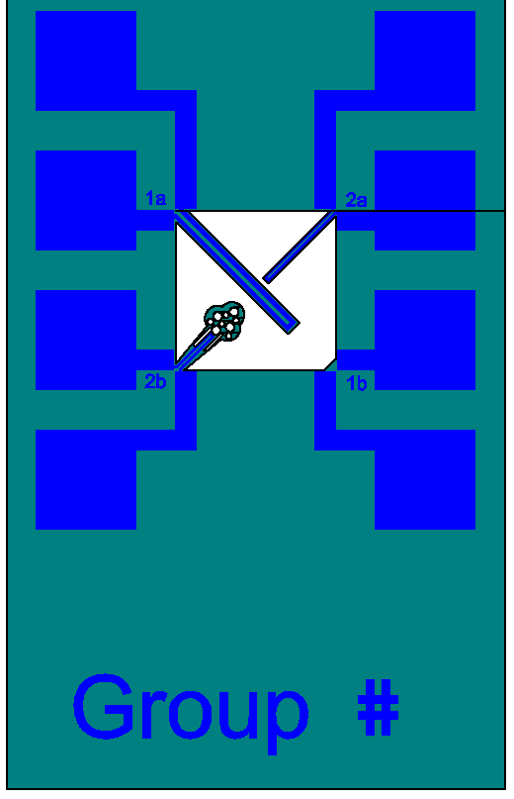
2nd A1 session – tasks for Thursday Oct 8th 8h

